Slide 1

UNIVERSITY OF MESSINA
Department
Cognitive Science and Theory of Communication – LM-55
Course Title
SOCIAL SEMIOTICS
Teacher
Maria Rita Bartolomei
Mail: mabartolomei@unime.it

Slide 2



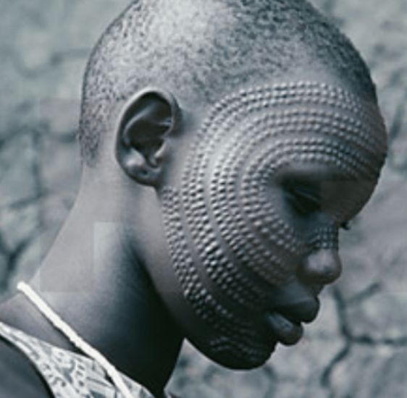
SOCIAL SEMIOTICS
Semantics of the human body
The body as a social and cultural fact
tattoo – piercing – scarification

Slide 3



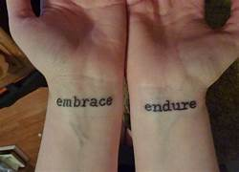
SOCIAL SEMIOTICS
Semantics of the human body
Tattoo: artificial and permanent alteration of skin tissue

Slide 4

SOCIAL SEMIOTICS
Semantics of the human body
Tattoo
the marks are imprinted on the skin by puncture
carefully distributed pigments
are introduced into the dermis
along the lines of a drawing
when wounds heal
the pigments give shape
to the final image

Slide 5

SOCIAL SEMIOTICS
Semantics of the human body
Tattoo
is a term that derives from the Tahitian onomatopoeic word
“ta-tau”
it reproduces the sound of tapping
the stick on the needle to pierce
the skin
it means "to hit", "to mark"; i.e.,
“marking the body with signs”
James Cook transcribed it as tattow
later became tattoo

Slide 6


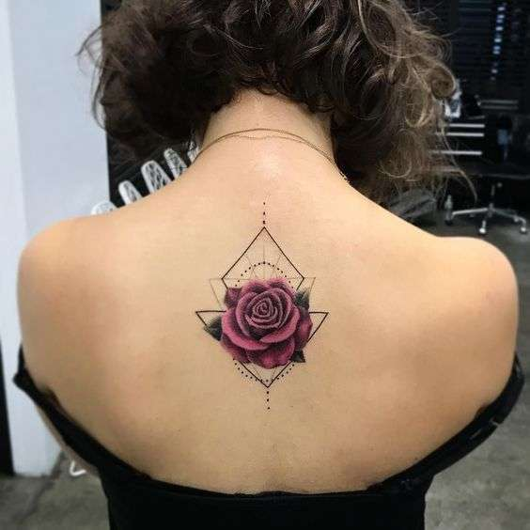
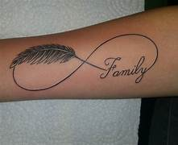
SOCIAL SEMIOTICS
Semantics of the human body
Tattoo is a visible sign whose dimensions can vary
from very small to covering the entire body

Slide 7
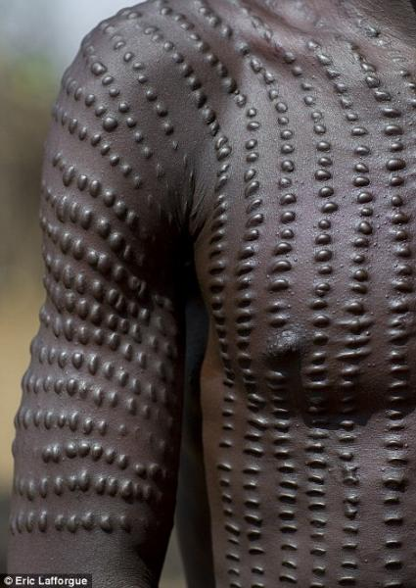
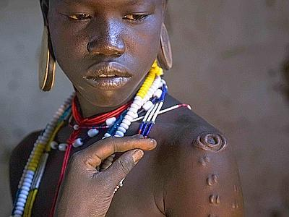
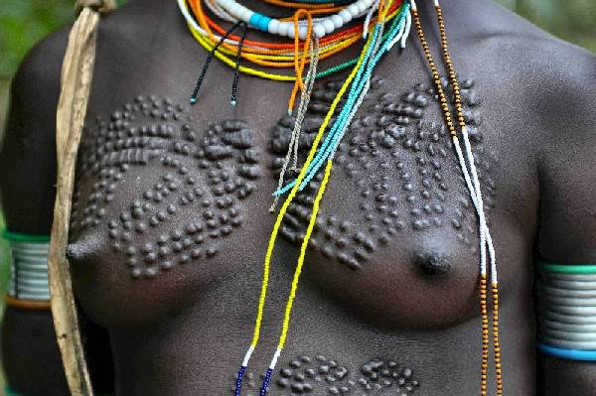
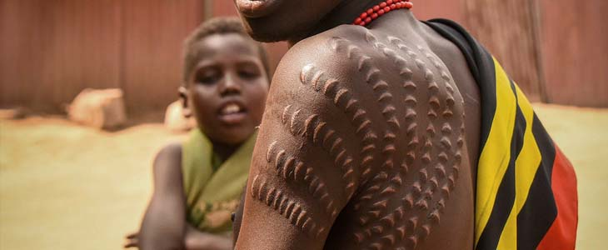
SOCIAL SEMIOTICS
Semantics of the human body
Dark-skinned populations mainly use scarification
Deep incisions are made on the skin of the body and face

Slide 8
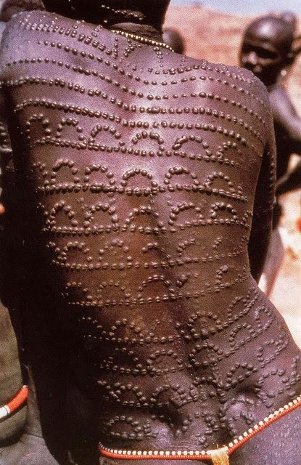
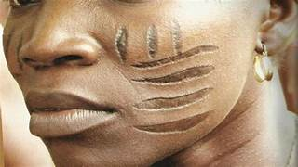
SOCIAL SEMIOTICS
Semantics of the human body
Seeds, small grains or other substances are
introduced into the wound, to
increase the volume of scars
delay the healing of wounds
create designs and forms in a kind of bas-relief

Slide 9
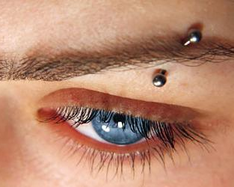


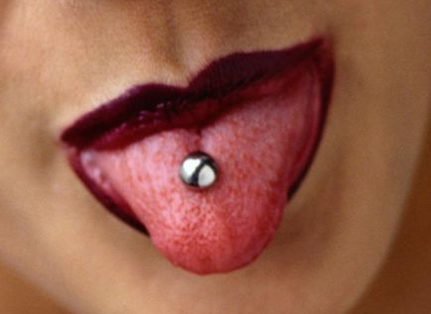
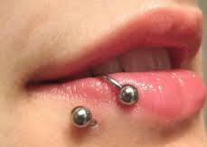
SOCIAL SEMIOTICS
Semantics of the human body
Piercing
perforation of certain parts of the body (lips, nose, cheeks, etc.) to insert rings, earrings, pins, brooches
by extension, the word also indicates the inserted object
is a custom which has tribal origins

Slide 10
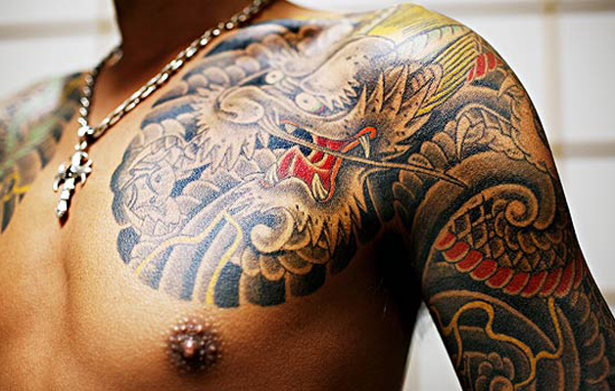
SOCIAL SEMIOTICS
Semantics of the human body
In the West, the tattoo phenomenon was born within specific subcultural contexts for different reasons
opposition to dominant social norms
criticism of and protest against the system
transgression
deep individual malaise
identification with reference models
individual research

Slide 11
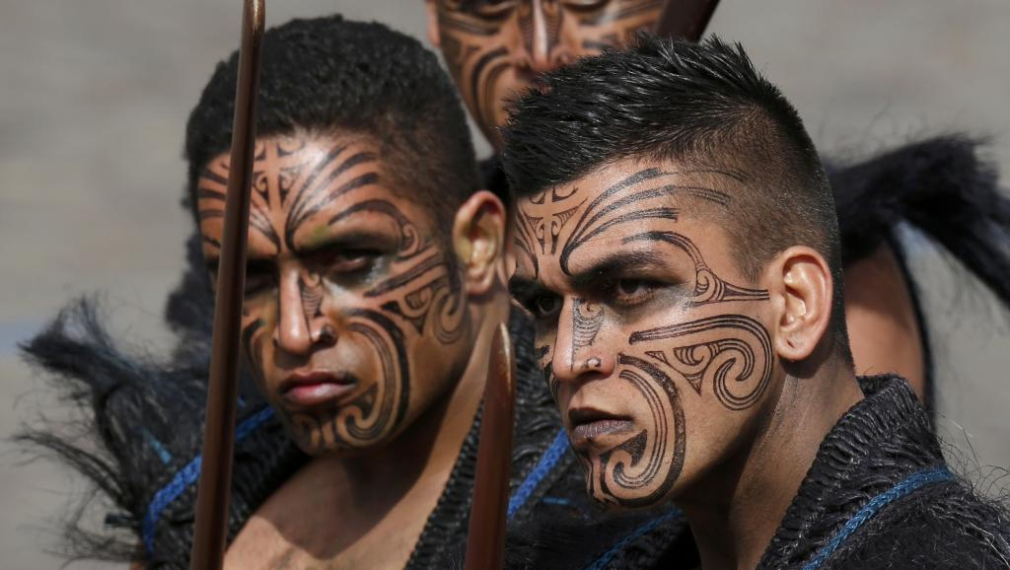

SOCIAL SEMIOTICS
Semantics of the human body
In the collective imagination, tattooing had a negative connotation
often associated with cultures defined as “primitive”,
“savage” or “irrational”
was considered an expression of
- dispute
- deviance
- mental weakness
- moral disorder

Slide 12




SOCIAL SEMIOTICS
Semantics of the human body
Tattooing has strongly characterised the life of individuals
making a positive or negative contribution, depending on the case

Slide 13

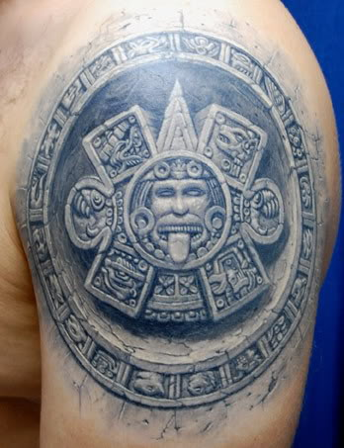
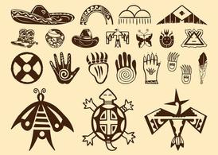
SOCIAL SEMIOTICS
Semantics of the human body
Tattooing is a widespread practice in almost all past and present
societies

Slide 14
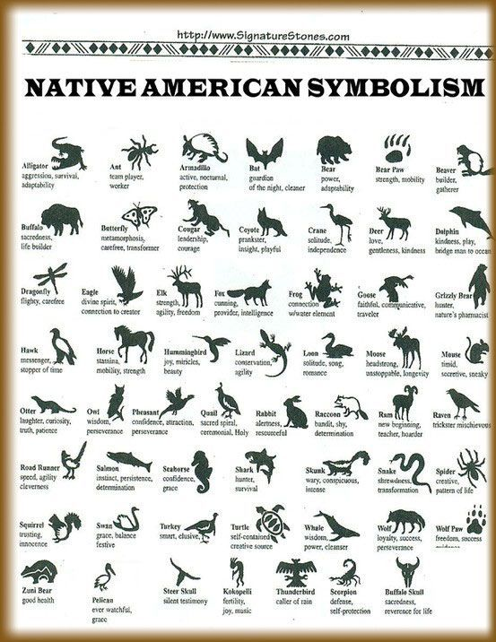
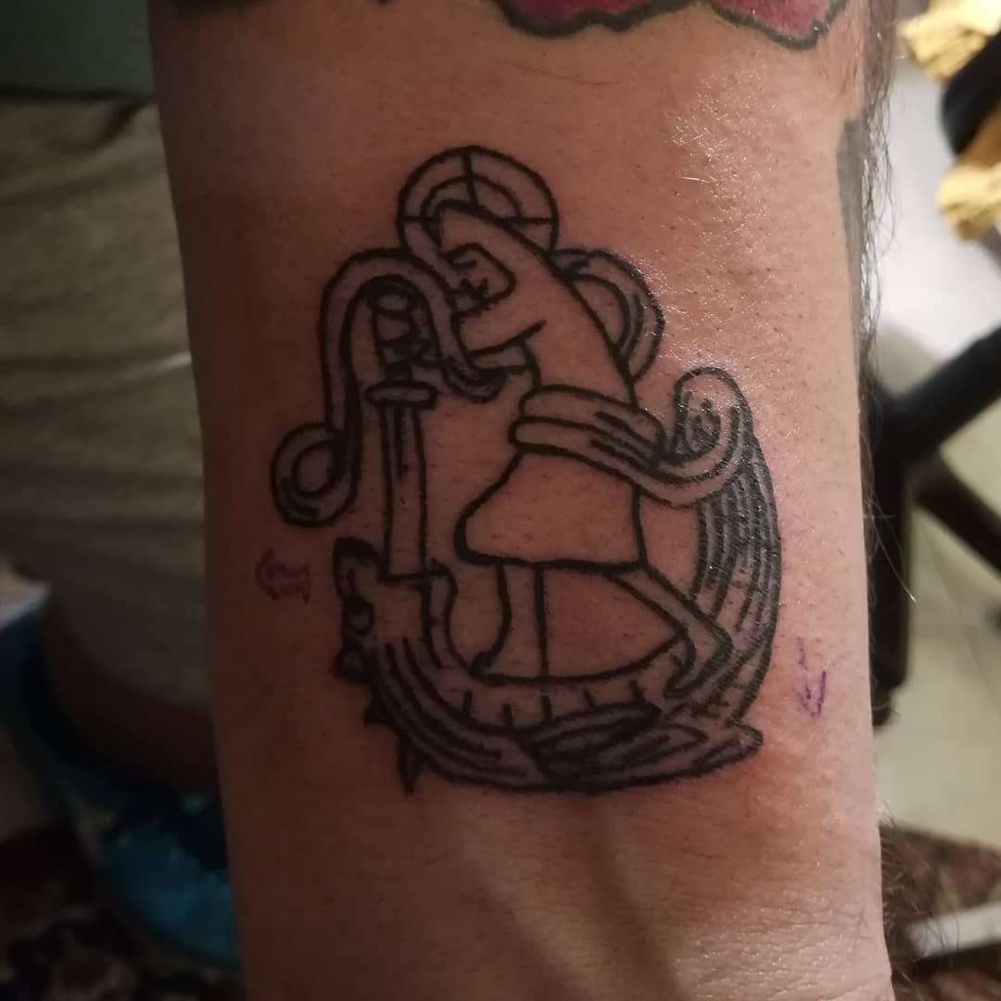
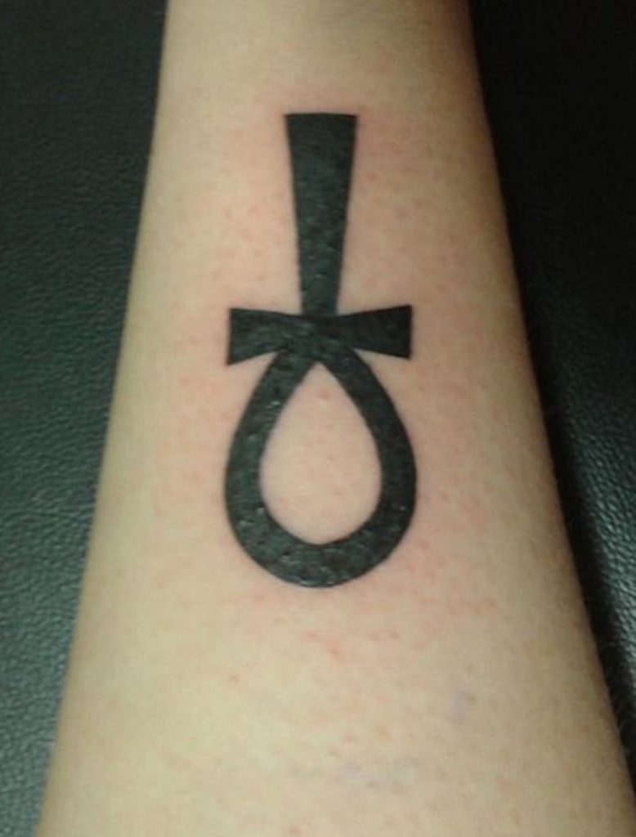

SOCIAL SEMIOTICS
Semantics of the human body
Tattooing is an ever-present practice in the history of humanity

Slide 15
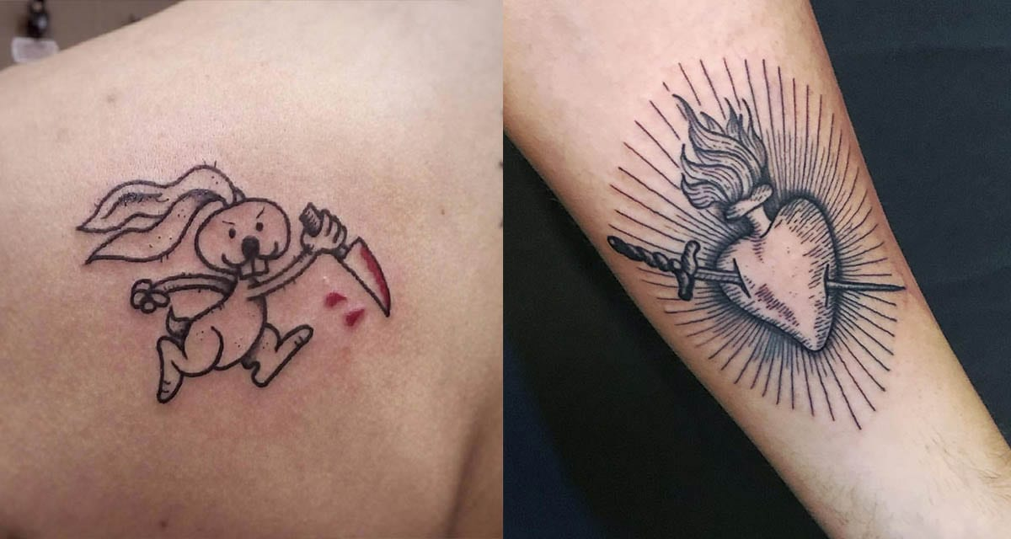


SOCIAL SEMIOTICS
Semantics of the human body
Every mark on the body
is a graphic expression of the culture we belong to
is a specific language through which a biological
body is transformed into a cultural body

Slide 16
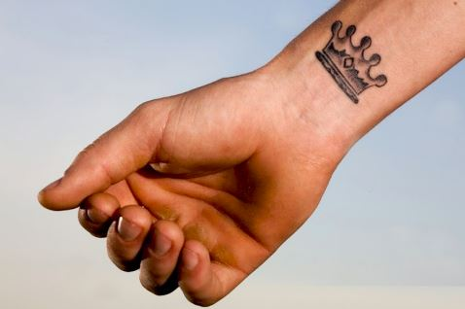
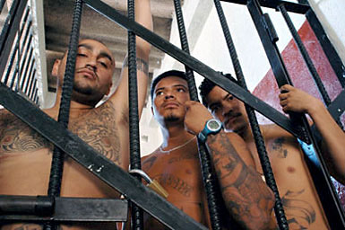

SOCIAL SEMIOTICS
Semantics of the human body
Every mark on the body expresses a meaning
a body which is also and above all built in the relationship with another body
with the image of oneself which each of us intends to communicate

Slide 17
SOCIAL SEMIOTICS
Semantics of the human body
Each type of tattoo or piercing represents an attempt
to overcome an object conception of the body
to affirm and vindicate
- one’s own subjectivity
- a specific social identity
- individual and collective belonging
it is a way of converting the body I have into the body I am

Slide 18
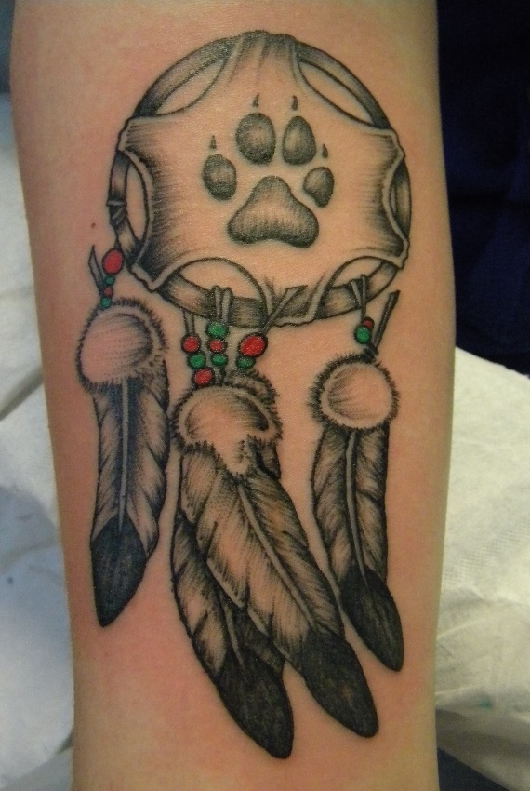
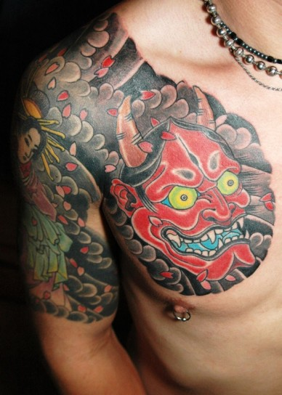
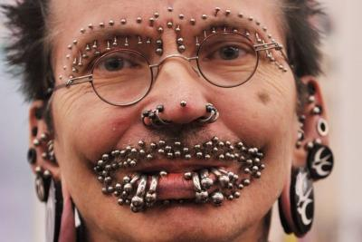
SOCIAL SEMIOTICS
Semantics of the human body
Tattooing and piercing perform multiple functions, which sometimes range
from the therapeutic, superstitious and apotropaic one, to that of initiation

Slide 19
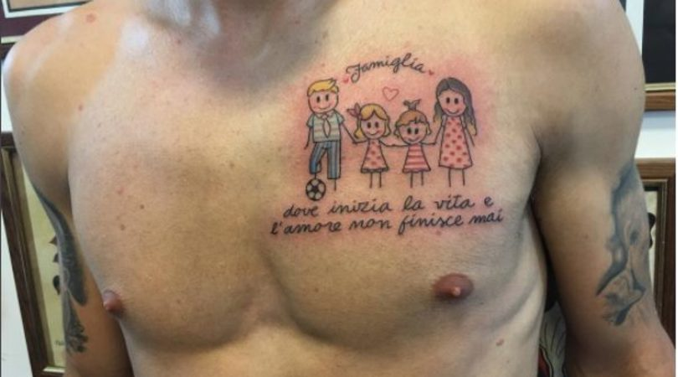
SOCIAL SEMIOTICS
Semantics of the human body
Tattooing, piercing and scarification are artistic practices
which have the power to define
who is worthy of belonging to a community
who is excluded

Slide 20



SOCIAL SEMIOTICS
Semantics of the human body
As a system of transmission of knowledge and culture
tattooing, piercing and scarification continued to be perceived
like a visual language of the skin
on which culture is written, lived and preserved in a myriad of specific ways

Slide 21
SOCIAL SEMIOTICS
Semantics of the human body
The body as a social and cultural fact

Slide 22
SOCIAL SEMIOTICS
Semantics of the human body
The body as a social and cultural fact

Slide 23
SOCIAL SEMIOTICS
Semantics of the human body
The body as a social and cultural fact

Slide 24
SOCIAL SEMIOTICS
Semantics of the human body
The body as a social and cultural fact

Slide 25
SOCIAL SEMIOTICS
Semantics of the human body
The body as a social and cultural fact

